Slide 1
How to make the best use of Live Sessions
Please login on time
Please do a check on your network connection and audio before the class to have a smooth session
All participants will be on mute, by default. You will be unmuted when requested or as needed
Please use the “Questions” panel on your webinar tool to interact with the instructor at any point during the class
Ask and answer questions to make your learning interactive
Please have the support phone number (US : 1855 818 0063 (toll free), India : +91 90191 17772) and raise tickets from LMS in case of any issues with the tool
Most often logging off or rejoining will help solve the tool related issues

Slide 2



Configuration Management with Ansible

Slide 3
Objective
Upon completing this module, you should be able to:
Install Ansible on your machine
Write Ansible Playbooks
Execute ad-hoc commands using Ansible
Differentiate Ansible and Puppet
Implement the part of Edureka’s Project associated with Ansible

Slide 4
Ansible: An Introduction

Slide 5

What is Ansible?
Ansible is a deployment automation tool which traditionally uses push approach to achieve its objectives, by managing all the servers through one single machine running the Ansible Configuration Management Tool.

Slide 6


Ansible Push Approach
Ansible clients do not have any agents installed on them, therefore there is no concept of polling with central server. Ansible uses the Push approach instead. Still, Ansible is flexible enough to let the user implement Pull architecture as well.
push

Slide 7



How is Push different from Pull?
PUSH | PULL
Push approach does not require agents set up on individual nodes like pull does | Pull works in a master slave architecture which requires agents set up on all slave nodes
Push based systems are completely Synchronous as you can see the changes made instantaneously and can fix the system if changes cause problems | Systems using pull architecture can scale quite easily which is not the case with push model

Slide 8
Why Ansible?

Slide 9





Why Ansible?
Agentless
Ansible uses OpenSSH and WinRM as transport to achieve automation. It is completely agentless, therefore making it a more efficient and secure option.
Simple
Ansible uses YAML(Yet Another Mark-up Language) which is very simple and readable. No special coding skills are required to write in YAML
Powerful
Ansible can be used to manage entire infrastructure of an application. It can orchestrate the entire application and environment lifecycle no matter where it is deployed.
Accessible
If someone automates something in Ansible, everyone on the team now knows how it is done.

Slide 10




Ansible vs Others
Ansible is much easier to work with compared to the likes of Puppet, Chef etc
Ansible does not require agents set up on individual nodes
Ansible also supports the pull architecture
It’s simple enough for new users and also works at high enough level to work with other tools as well

Slide 11
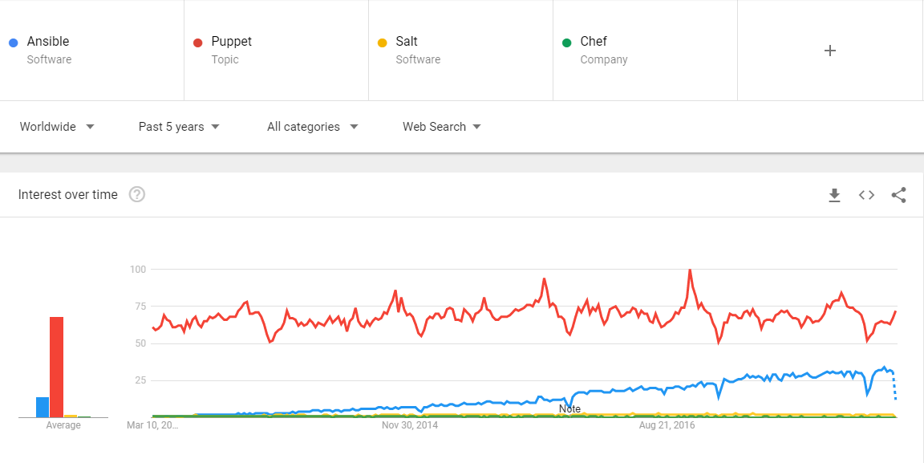

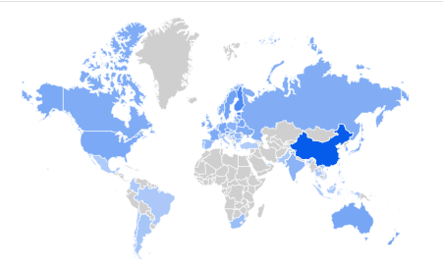
Ansible in the Industry
Hmmm… Ansible is gaining popularity in the industry
Configuration Management tools Popularity by Google Trends

Slide 12
Ansible Architecture

Slide 13
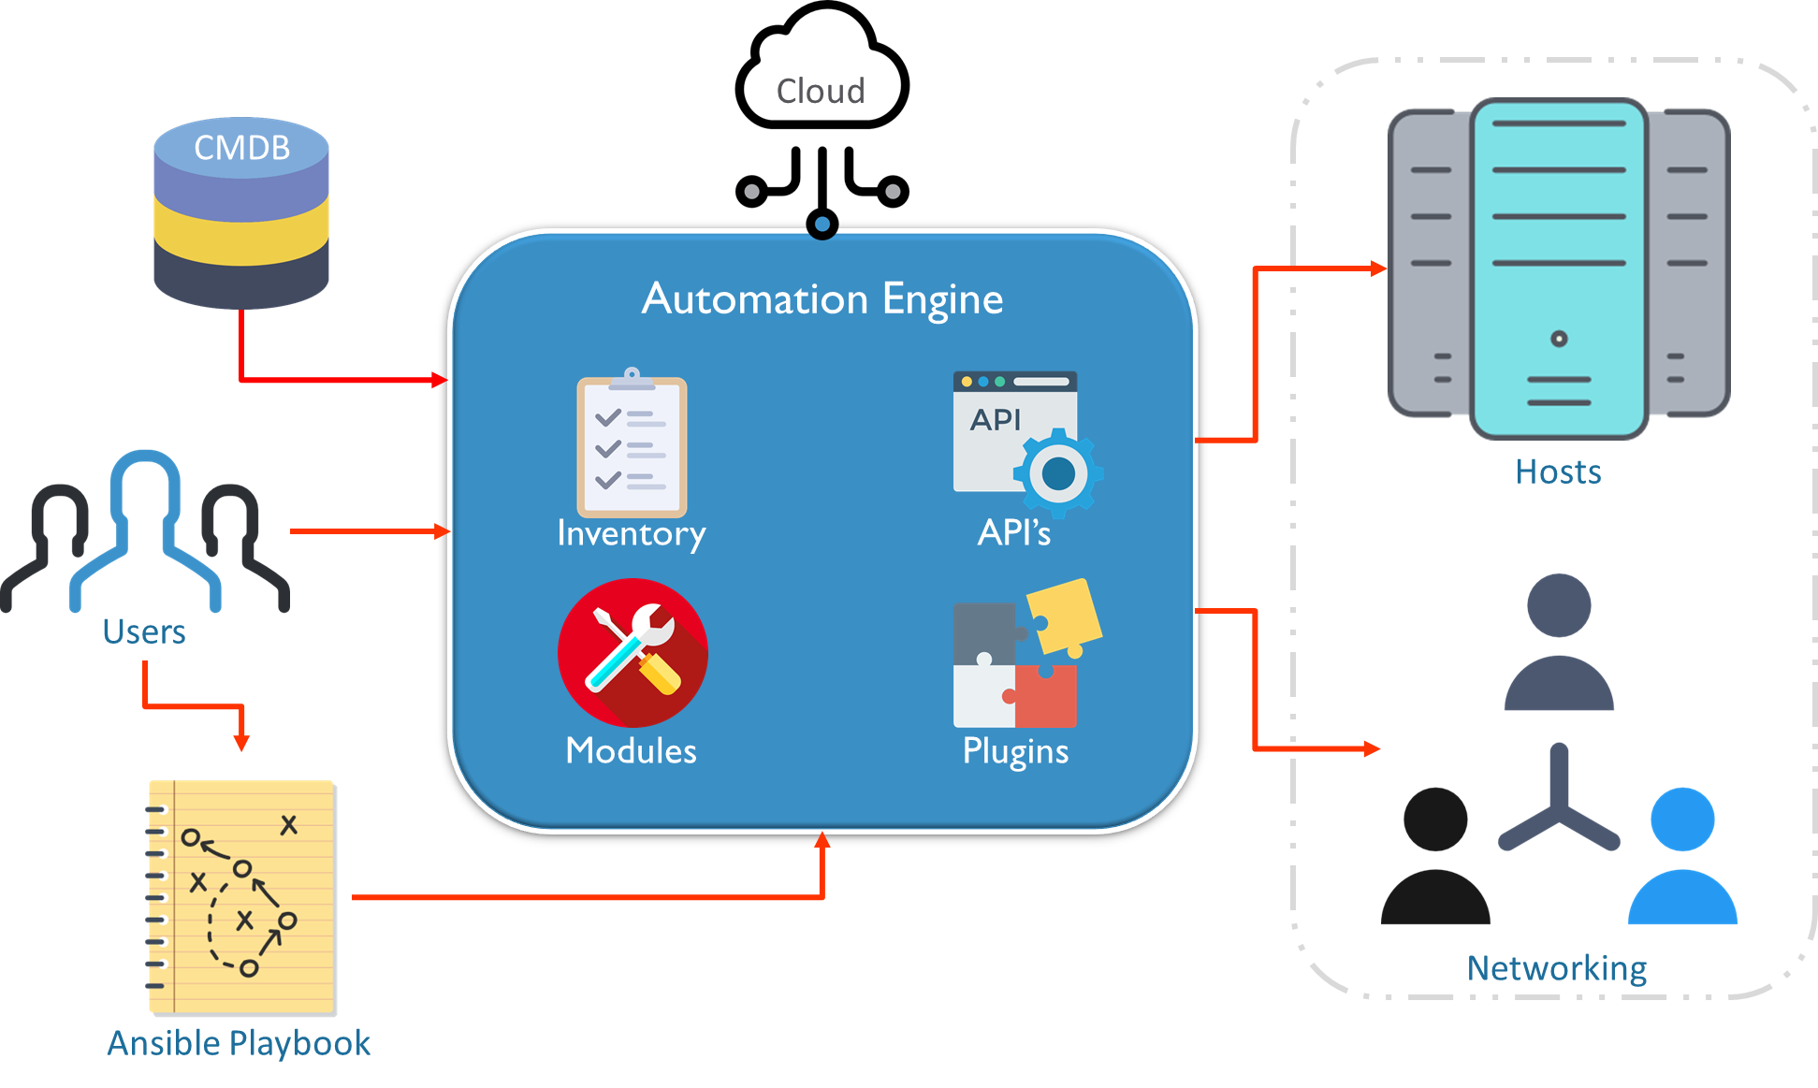
Ansible Architecture
Ansible connects to the nodes and pushes out small programs called ‘Modules’. These Modules bring the systems to the desired state. Ansible uses SSH to execute these modules and then removes them when finished

Slide 14




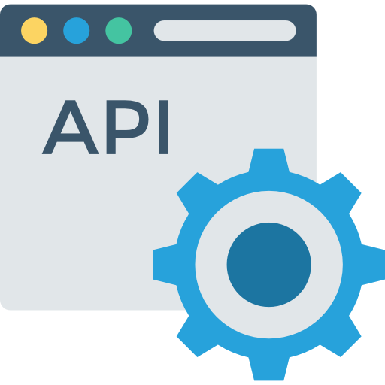




Cloud
CMDB
Automation Engine
Hosts
Inventory
API’s
Users
Modules
Plugins
Networking
Ansible Playbook

Slide 15
Ansible Architecture: Playbooks
Ansible uses playbooks to implement the changes desired by the users.
Playbooks contain plays, plays have tasks and tasks call modules.
Modules are the units which actually execute on the servers.

Slide 16
Ansible Architecture: Automation Engine
The Ansible automation engine contains everything needed to bring about automation in the infrastructure

Slide 17
Ansible Architecture: Automation Engine
Ansible uses the inventory file to represent all the machines it is managing
Users can then group the machines to their own liking

Slide 18
Ansible Architecture: Automation Engine
The API’s in Ansible are there to support services like cloud and CLI
Eg. Python API is used for Command Line Interface

Slide 19
Ansible Architecture: Automation Engine
Plugins act as extension to Ansible
Eg. Action plugin lets you perform tasks on your Ansible machine before you execute a playbook

Slide 20
Ansible Architecture: CMDB
The configuration management database keeps a record of all the configuration changes made in the system
This database could be kept on the cloud platform or on the physical server as well

Slide 21
Ansible Architecture: Cloud
Ansible has a huge support for numerous cloud applications
These cloud applications can seamlessly be integrated with Ansible
Ansible makes provisioning cloud infrastructures easy

Slide 22
Ansible Architecture: Hosts and the Network
The hosts are connected to the Ansible system via secure SSH connection (though other encryption technologies can also be used).
Different networks can be managed together giving each network separate access rights.

Slide 23
Installing and Configuring Ansible

Slide 24

Installing Ansible: Prerequisites
Ansible requires a secure transport to nodes, hence openssh(linux/unix) or winrm(windows) must be setup on each machine
Latest python libraries must be installed on the Ansible machine

Slide 25
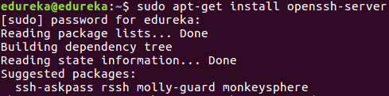
Setting Up SSH
Ansible uses SSH to communicate between nodes
To set up SSH install the openssh-server package on all of your machines
Syntax: sudo apt-get install openssh-server

Slide 26
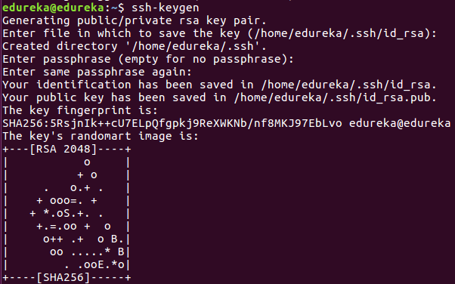
Generating SSH Key
On the machine with Ansible, generate the SSH key
Syntax: ssh-keygen
This is the default path where the key is saved.

Slide 27
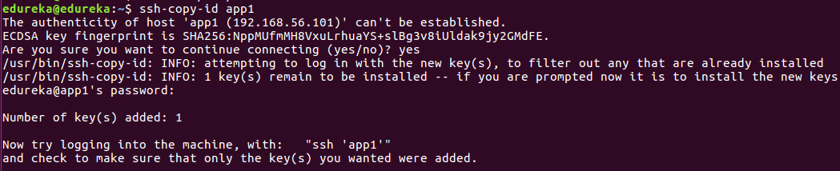
Copy the SSH Key on the Hosts
Copy the generated SSH keys onto the hosts using copy id command
Syntax: ssh-copy-id hostName

Slide 28
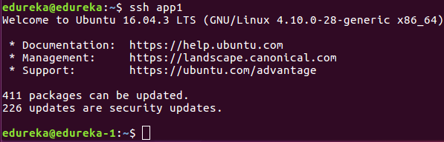
Check the SSH Connection
Now, check the SSH connection using the ssh command
Syntax: ssh <nodeName>
User has logged into the remote server/host

Slide 29
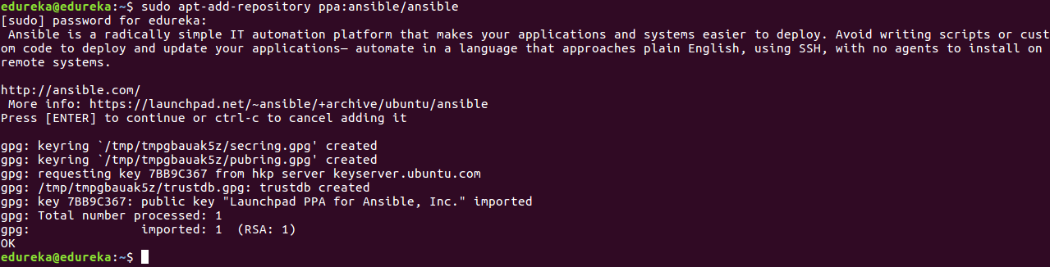
Installing Ansible
Before installing Ansible package add Ansible repository to your system
Syntax: sudo apt-add-repository ppa:ansible/ansible

Slide 30
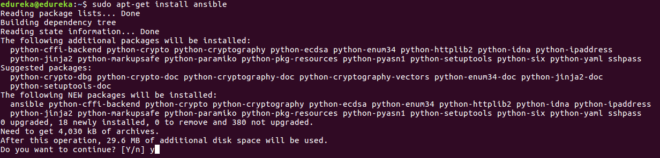
Installing Ansible
Run the update command before installing to update existing packages
Now install the Ansible package
Syntax: sudo apt-get update
Syntax: sudo apt-get install ansible

Slide 31
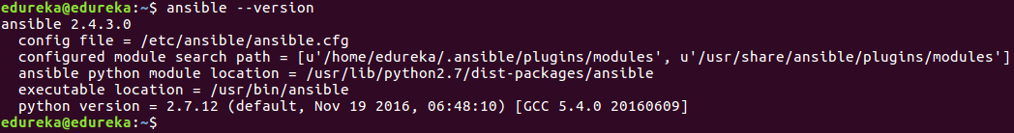
Installing Ansible
You can check if you’re on the latest version of Ansible by running the version command
If for some reason an older version of Ansible is installed on your system you can run the update command again to get the latest version
Syntax: ansible --version

Slide 32
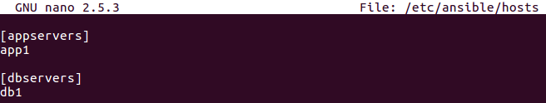
Configuring Ansible: Setting-up Hosts(Inventory)
To set up hosts you need to edit the hosts file in the Ansible directory
Syntax: sudo nano /etc/ansible/hosts
Servers can be grouped together in the Inventory by using square brackets
You can list servers within groups or even as individuals without groups

Slide 33
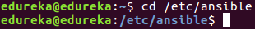
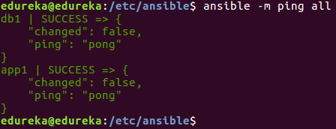
Checking Connection to Hosts
Change your directory to /etc/Ansible
Now you can check if Ansible’s connection with your hosts in your inventory file is good
Use the Ansible’s ping module to check whether or not Ansible is connecting to hosts
Syntax: cd /etc/ansible
Syntax: ansible –m ping <hosts>

Slide 34
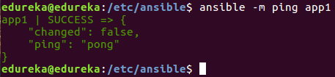
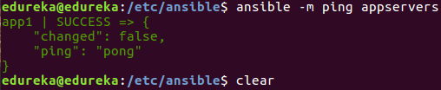
Checking Connection to Hosts
You can also check on servers individually
Or check a particular server group

Slide 35
Ad-Hoc Commands

Slide 36

Ansible Ad-Hoc Commands
Ansible Ad-Hoc commands are used to accomplish tasks quickly
These commands are mostly used for one-off tasks
Ad-Hoc commands are handy to get small tasks done quickly

Slide 37

Ad-Hoc Commands
The Ansible command used earlier to check for working connection with hosts was indeed an Ad-Hoc command
Every task in Playbooks can be done by using Ad-Hoc commands
Ad-hoc commands do nothing in terms of bringing in automation

Slide 38
Demo: Ad-Hoc Commands

Slide 39
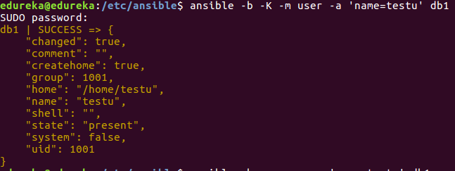
Ad-Hoc Commands: Example
Adding a user to a host using an Ansible ad-hoc command
Different flags are used in ad-hoc commands for different tasks(-m flag is used to specify module)

Slide 40
Automation Using Ansible

Slide 41

Infrastructure Automation Using Ansible
Ansible’s simple and powerful interface makes it an ideal tool to automate deployment, provisioning, orchestration and configuration management. Ansible easily integrates into almost every provisioning infrastructure using its Playbook-based automation.

Slide 42
The Ansible Automation Engine
The Ansible’s automation engine is the powerhouse behind such a simple yet powerful tool. The automation engine consists of everything that aids in bringing about automation to an organizations infrastructure. It contains the inventory file, playbooks, modules, API’s and plugins.
Automation Engine
Playbook
Inventory
Modules
API’s
Plugins

Slide 43

Automation Engine: Inventory
Ansible’s inventory lists all the platforms you want to automate across. Ansible can at a single instance work on multiple hosts in the infrastructure. It is also possible to have multiple inventory files at the same time.

Slide 44

Automation Engine: Inventory Hosts and Groups
The host inventory file can contain host names either individually or in groups
Host Groups can be created by giving a group name within square brackets
Group members can then be listed under, till there is a line break

Slide 45
Playbooks

Slide 46

What exactly is a Playbook?
Playbooks are the access point to Ansible provisioning.
It’s the Ansible’s way of deploying and configuring different remote servers and environments
It is written in YAML(Yet Another Mark-up Language)
On an advanced level playbooks can be used to
Handle multi-tier rollouts
Load balancing tasks for the servers

Slide 47

Ansible Playbook: Modules
Modules are units which actually get the work done in Ansible. Ansible’s module are used to control system resources, like services, packages, execute system commands, or files. There are over 450 in-built modules in Ansible.

Slide 48
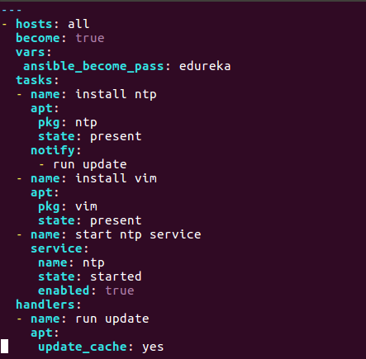
Ansible Playbook: Modules
Modules abstract system tasks, like dealing with packages or handling files from Ansible servers
Users can choose to either use a module from Ansible’s in-built library or create their own custom modules
Almost all of the modules support taking arguments in key-value format
Modules

Slide 49

Ansible Playbook: Plugins
Plugins allow Ansible to execute playbook tasks as job build step. Plugins provide extra functionality to Ansible. Similar to Modules, Ansible ships with a large number of plugins and users can also build and apply their own.

Slide 50
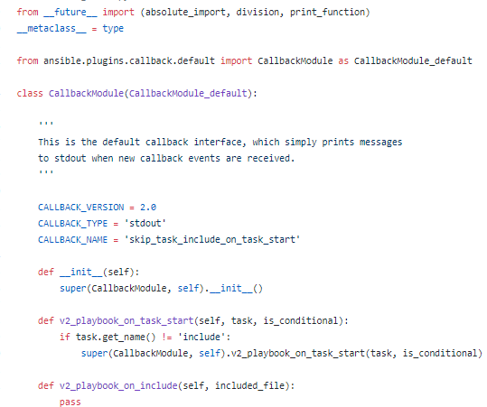
Ansible Playbook: Plugins
Plugins can act as front ends to modules i.e. they can execute some tasks before a specific module is called
Callback plugins enable you to hook into Ansible events for display or logging purposes
To avoid expensive fact-gathering tools, Ansible also provides cache plugins to gather ‘facts’
Callback Plugin Code

Slide 51

Ansible Playbook: Variables
Variables are Ansibles way to deal with differences between different systems and environments. Variables can handle the minor(or major) differences between systems with same configuration. Users can also collect information from other remote systems(called facts) and store them in variables.

Slide 52
Ansible Playbook: Variables
Variables can be defined and used anywhere in Ansible even in inventory or in an Ad-Hoc command
Variables extend the functionality of conditionals and loops in Ansible
tasks:
- name: copy files
copy: src={{ item }} dest=/tmp/{{ item }}
with_items:
- alha
- beta
Variables

Slide 53
Writing Playbooks

Slide 54


Writing Playbooks: Points to Remember
Ansible Playbooks are written in YAML(Yet Another Mark-up Language) and saved with the extension .yml
YAML is a simple human readable language which focuses entirely on indentation to define blocks
Multiple plays can be written in a single playbook

Slide 55
Playbook Structure
Besides the basic structure of a YAML file there are a few things to be kept in mind before writing a playbook.
Note: This is a sample playbook

Slide 56
Playbook Structure
All playbooks(YAML files) start with three hyphens in the top left corner.

Slide 57
Playbook Structure: Hosts
Each play in a playbook starts with the host(s) the play is supposed to be executed on.
Hosts also defines the start of the play
There may be multiple plays in a single playbook

Slide 58
Playbook Structure: Vars
Variables are defined by using the vars keyword
Playbooks are executed line by line hence variables need to be defined before their use in playbooks

Slide 59
Playbook Structure: Become
Become here is used to become a different user than the one logged into the remote machine
This is mainly done for Privilege Escalation
For example gaining su access

Slide 60
Playbook Structure: Tasks
All the tasks that are to be executed on remote systems are defined under the tasks section
A single play can consist multiple tasks
Tasks are executed in order

Slide 61
Playbook Structure: Handlers
Tasks may contain notify actions which are triggered at the end of a block
Notify triggers are call upon tasks in the handler section
Handlers are tasks which are executed only once for every play

Slide 62
Demo: Ansible Playbook

Slide 63
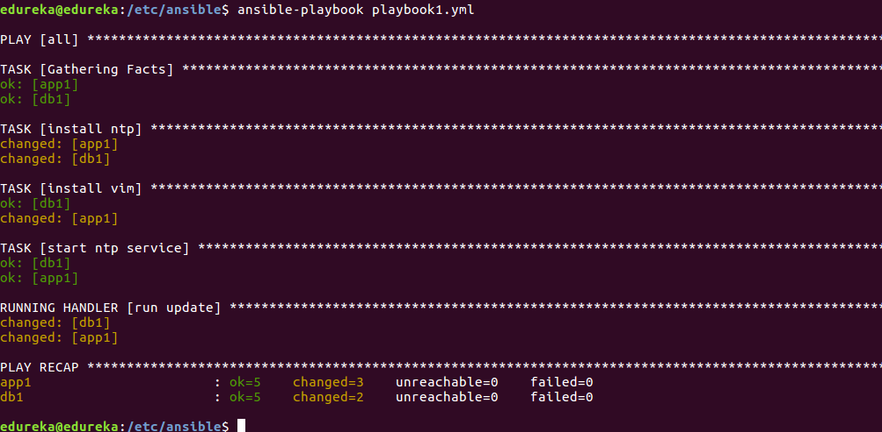
Ansible Playbook: Executing a Playbook
To execute a playbook use the Ansible-playbook command
Syntax: ansible-playbook playbookName.yml

Slide 64
Ansible Roles

Slide 65

Ansible Roles
Overtime working with Ansible a user may create hundreds of playbooks, variables, templates, defaults etc. Roles allow users to group this logic into an organized manner making reusability and sharing of Ansible structure easier.

Slide 66




Ansible Roles
Roles uses directories to structure and group all the playbooks, variables, templates, tasks, handlers, files, and defaults.
This collected logic can be grouped in any way the user wants, for example you can group server specific roles together
These roles can then be used inside playbooks and even as in-line commands
Defaults
Vars
Handlers
Tasks
Ansible Host folder
Roles
Role-name
Files
Meta
Template

Slide 67
Ansible Roles: Creating a Role
To create a role a tool called Ansible-galaxy comes bundled with Ansible
Syntax: ansible-galaxy init roleName

Slide 68
Ansible Roles: Defaults
The defaults folder contains a file called main.yml
This main.yml file contains all the default variables to be used by the role

Slide 69
Ansible Roles: Files
Files houses all the files which are to be added to the host machine being configured
The files in the Files directory can be referenced through copy task
Files can not be modified while being added to the host machine

Slide 70
Ansible Roles: Handlers
All the handlers that may be used in the roles are kept in this directory

Slide 71
Ansible Roles: Meta
The meta folder houses another main.yml file
The main.yml file consists of metadata such as contributing author, dependencies, platforms, etc.

Slide 72
Ansible Roles: Tasks
Tasks contains the playbooks used by the role

Slide 73
Ansible Roles: Templates
Templates contains files which can be modified and added to the host being provisioned
Jinja2(template language) is used to achieve the modifications

Slide 74
Ansible Roles: Vars
Vars also holds variables like defaults does
The variables in vars have a higher priority compared to default variables
Vars variables are difficult to override

Slide 75
Ansible Roles: Calling a Role inside a Playbook
Roles can be called inside a playbook
All the logic of the role becomes the part of the playbook using it
---
- hosts: wordpress_hosts
roles:
- nginx
- php
- mysql
- wordpress

Slide 76
Demo: Ansible Roles

Slide 77
Demo: Using Ansible in In-Class Project

